Slide 1
The Product Life Cycle Ontologies and the IOF: Cases, Lessons, Best Practices
Proposal to the IOF
2. Best Practices
True Path and Defined Classes
Definitions
Against Relations
Processes are classes (not relations)
3. Patterns
Dispositions and Based in Qualities
Information and their Bearers
Realizable Entities and their Contexts
Signing Contracts for Services
Training, Developing Skills, Using Skills
Creating Measurements and creating Ratios
https://github.com/NCOR-US/CHAMP
Notes:
For the last two years, I have been leading a team at UB to create a series of modular ontologies for the product life cycle. This talk draws lessons from them to outline some best practices and discuss some patterns and insights I hope will be helpful for this group.

Slide 2
Coordinated Holistic Alignment of Manufacturing Processes (CHAMP)
J. Neil Otte, project manager for CHAMP
ph.d. candidate,
philosophy department, University of Buffalo (SUNY)
The National Center for Ontological Research
neilotte@gmail.com
https://github.com/NCOR-US/CHAMP

Slide 3
Coordinated Holistic Alignment of Manufacturing Processes (CHAMP)
University at Buffalo
Barry Smith, PI
Kemper Lewis, Co-PI
Rahul Rai, Co-PI
CUBRC
Ron Rudnicki
William Tagliagerri
Remo Fischione
Cobham Mission Systems
Jim Talty
Lucas Mesmer
funding provided by

Slide 4
Coordinated Holistic Alignment of Manufacturing Processes (CHAMP)
The goal of CHAMP is to:
create a suite of modular, reference ontologies representing the product life-cycle (PLC).
create a browser and ingestion tool for working directly with an RDF triplestore.
https://github.com/NCOR-US/CHAMP

Slide 5
Proposal to the IOF
First, the IOF ought to officially adopt Basic Formal Ontology and the Common Core Ontologies as mid-level ontologies.

Slide 6
Proposal to the IOF
First, the IOF ought to officially adopt Basic Formal Ontology and the Common Core Ontologies as mid-level ontologies.
Second, the IOF ought to start with the Product Life Cycle Ontologies, and revise, extend, and replace them as needed.
Notes:
The thought here is that the PLC ontologies we have developed are in draft, but they would provide an excellent starting place for future extensions of BFO+CCO within the industrial manufacturing domain. As they are, they would show strategies for such alignments, and they would be easy to merge with other BFO conformant ontologies.

Slide 7
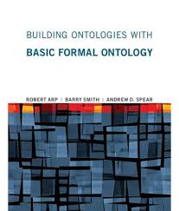
Basic Formal Ontology (BFO)
BFO is widely used, well-documented, and highly successful.
Adopting BFO will bring in the resources of the National Center for Ontological Research.
Notes:
There’s no real need to introduce BFO to this group, but here are some practical reasons for adopting it.

Slide 8
Basic Formal Ontology (BFO)
BFO is widely used, well-documented, and highly successful.
Adopting BFO will bring in the resources of the National Center for Ontological Research.
BFO has been approved as ISO/IEC standard 21838-2
BFO is available in both OWL and CL (CLIF and FOL) formats.

Slide 9
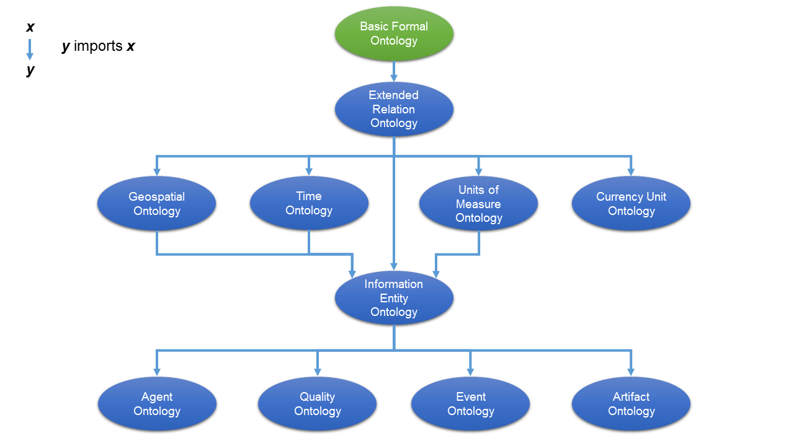
The Common Core Ontologies
https://github.com/CommonCoreOntology/CommonCoreOntologies
Notes:
The CCO were only made publicly available in November, so ontologies should explore and began working with them. They would be particularly good for this group to explore, since they are more relevant to industry than many of the obofoundry ontologies.

Slide 10
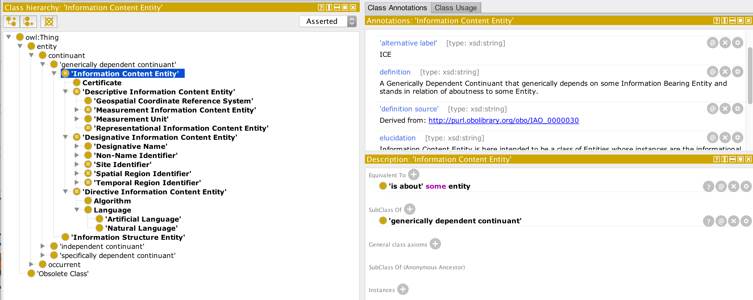
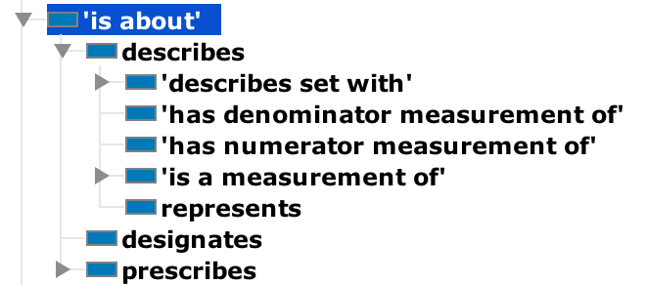
The Common Core Ontologies:
Information Entity Ontology (INFO)
https://github.com/CommonCoreOntology/CommonCoreOntologies
Notes:
The treatment of information is more complete and streamlined than much of the IAO.

Slide 11
Proposal
Basic Formal Ontology (BFO)
The Common Core Ontologies (CCO)
Quality
Time
Agent
Artifact
Event
Unit
Geospatial
Info
The Product Life Cycle Ontologies (PLC)
Business Flow Ontology
Product Lifecycle Ontology
Design
Commercial Entities Ontology (CEO)
Services Ontology
End of Life Ontology
Manufacturing Process Ontology
Testing Process Ontology
Logistics Ontology
Artifact Use Ontology
Maintenance Ontology
Machine and Tool Ontology
CAD Ontology
Materials Property Ontology (MatOnto)
Addictive Manufacturing Ontology
Unix Permissions Ontology
Functionally Graded Materials Ontology
Notes:
Here is the full suite of ontologies we’ve been working with or have planned. Note: those ontologies within the PLC that in white are those that are still planned. The ones in red have been drafted and MatOnto is presently in active development.

Slide 12
Coordinated Holistic Alignment of Manufacturing Processes (CHAMP)
Commercial Entities Ontology (CEO)
The Product Life Cycle Ontology Suite as of 4/24/18
imported by
Service Ontology (SO)
imported by
Product Life Cycle (PLC)
Ontology
MachinesTools
imported by
Production Processes
imported by
imported by
imported by
Testing Processes
Design Processes
Notes:
Import structure of the PLC suite.

Slide 13
Coordinated Holistic Alignment of Manufacturing Processes (CHAMP)
A Note on these Graphs
Sally
agent in
Act of Education
occurs on
Temporal Region 1
Notes:
Here is a course-level view of the life of an employee.

Slide 14
Coordinated Holistic Alignment of Manufacturing Processes (CHAMP)
A Note on these Graphs
Sally
agent in
participates in
bearer of
Act of Education
Act of Hiring
has output
Employee Role
occurs on
occurs on
Temporal Region 1
Temporal Region 2
Notes:
When she’s hired, she acquires an employee role.

Slide 15
Coordinated Holistic Alignment of Manufacturing Processes (CHAMP)
A Note on these Graphs
Sally
agent in
agent in
participates in
bearer of
Act of Education
Act of Hiring
Act of Retirement
has output
Employee Role
revoked by
occurs on
occurs on
occurs on
Temporal Region 1
Temporal Region 2
Temporal Region 3
Notes:
When she retires, she loses this role. By using roles, we are able to account for the fact that she is essentially a person, but she is not essentially an employee. She becomes an employee at a time, maintains this role through some period of time, and later loses it. Note that we can make sense of all of these times by establishing orderings among the temporal regions on which various processes occur. This-–along with temporal orderings among processes themselves—is the basic temporal representation available in OWL, which allows only two-place relations.

Slide 16
Coordinated Holistic Alignment of Manufacturing Processes (CHAMP)
A Note on these Graphs
Sally
agent in
at
agent in
participates in
bearer of
Temporal Region 4
Act of Education
Act of Hiring
Act of Retirement
has output
Employee Role
revoked by
occurs on
occurs on
occurs on
Temporal Region 1
Temporal Region 2
Temporal Region 3
Notes:
However, the FOL and CL formulation of BFO includes ternary relations among continuants, allowing us to say, directly, that X is part of Y at T, or as in this case, Sally is the bearer of an employee role AT Temporal region 4. Keep in mind that all of these graphs could be supplemented in these ways. My subject is not temporal reasoning as such, so I’ll set this complication aside and use only two place relations throughout.

Slide 17
Coordinated Holistic Alignment of Manufacturing Processes (CHAMP)
Best Practices
True Path and Defined Classes
Definitions
Against Relations
Processes are classes (not relations)

Slide 18
Coordinated Holistic Alignment of Manufacturing Processes (CHAMP)
is a
continuant
independent continuant
The True Path Rule: Every instance of a child class must also be an instance of every class that is a parent of the child class.
object
artifact
phone
iPhone
Notes:
At the heart of any ontology there is a class taxonomy, which may be used in reasoning provided the taxonomy is a monohierarchy that avoids multiple inheritance. The true path rule aids in the building of such a system.

Slide 19
Coordinated Holistic Alignment of Manufacturing Processes (CHAMP)
is a
continuant
independent continuant
object
Resource
Product
artifact
Commodity
phone
Apple Product
iPhone

Slide 20
Coordinated Holistic Alignment of Manufacturing Processes (CHAMP)
is a
continuant
independent continuant
object
Resource
Product
artifact
Commodity
phone
Apple Product
iPhone
Notes:
In this domain, there is an understandable desire to add economic terms in order to represent those entities that fall under the guise of the market-place in various ways. Such entities might be for sale, or created to be sold, or acquired in order to accrue interest, or to be used but later resold or returned at cost. Such entities might begin being economic entities but lose this ability and become mere things that no longer serve as objects of economic planning and forecasting, or they may later acquire such a status, as when old furniture and silverware is putting up at auction in an estate sale. The question here is how to accommodate them among a hierarchy that is already organized according to a view of material entities unencumbered by value.

Slide 21
Coordinated Holistic Alignment of Manufacturing Processes (CHAMP)
Asserted vs. Defined Classes
Asserted classes are part of the official is_a hierarchy.
Asserted classes require motivation and incur ontological commitment.
Defined classes are composed from classes, individuals, and relations using equivalence axioms.
Using defined classes can help maintain adherence to the true path rule.
Notes:
In the BFO framework, asserted classes are universals. Defined classes do not correspond to universals. They are simply names whose instances are composed via logical representations among universals and relations. Thus in the BFO universe, there are no employees. There are people and there are employee roles. However, we could create a defined class ‘Employee’ equivalent to: person and bearer_of some employee role.

Slide 22
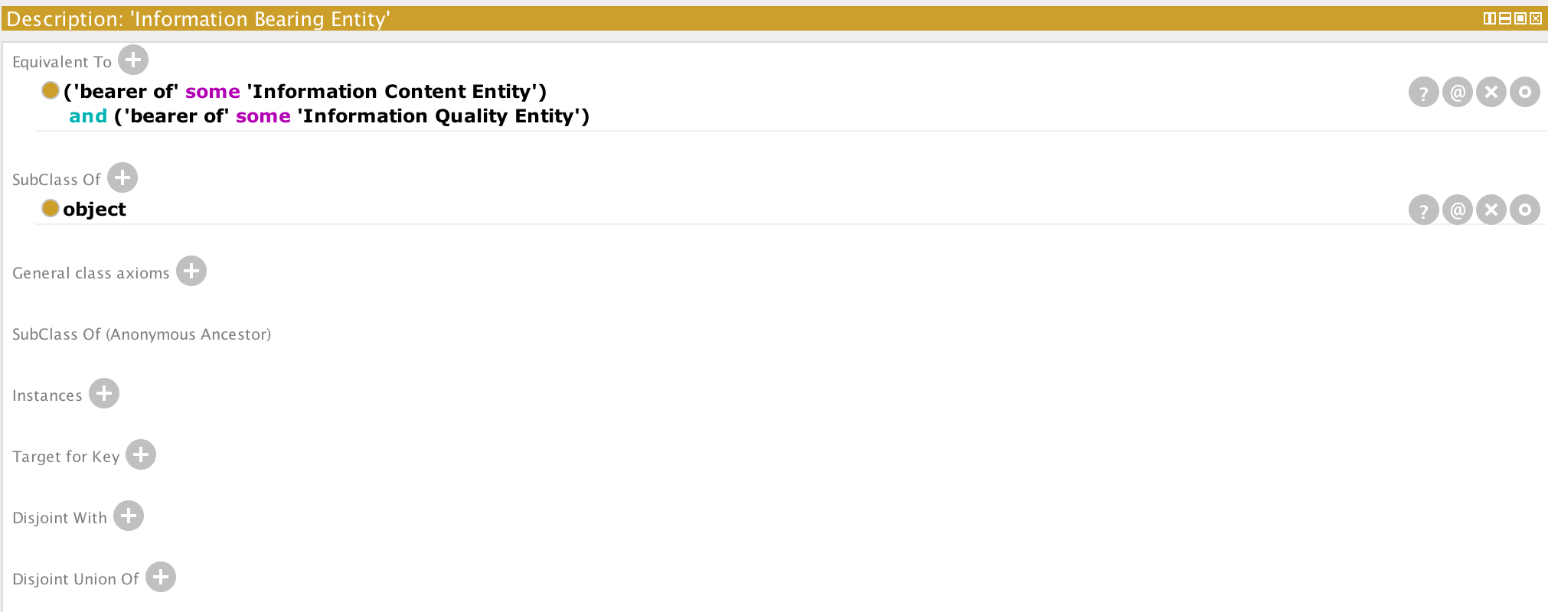
Restrictions:
Equivalent To
vs.
Subclass Of
Example: IAO: Information Bearers

Slide 23
Asserted vs. Defined Classes
Asserted Class
Instance
Defined Class
Person
subclass of
Employee
instance of
instance of
Sally

Slide 24
Asserted vs. Defined Classes
Asserted Class
Instance
Defined Class
Person
Role
subclass of
instance of
≡ Employee
Employee Role
bearer of
instance of
Sally
Employee ≡ Person and (bearer_of some ‘Employee role’)
Notes:
To do this, we can create a defined class.

Slide 25
Asserted vs. Defined Classes
Asserted Class
Instance
Defined Class
Person
Role
subclass of
instance of
≡ Employee
Employee Role
instance of
bearer of
Sally
Employee ≡ Person and (bearer_of some ‘Employee role’)
Notes:
When we run a reasoner in OWL, we can infer that Sally is a student based on how she satisfies the rest of the graph.

Slide 26
Avoid Doubling the Semantic Content of Classes in Relations
Person with Name
Person Name
has person name
Notes:
This one is fine. The relations are general, and they can be used for other purposes.

Slide 27
Avoid Doubling the Semantic Content of Classes in Relations
Person
Name
designated by
Notes:
This one is fine. The relations are general, and they can be used for other purposes.

Slide 28
Avoid Doubling the Semantic Content of Classes in Relations
Product
participates in
bearer of
Act of Artifact Use
Function
realized in
Notes:
This one is fine. The relations are general, and they can be used for other purposes.

Slide 29
Avoid Doubling the Semantic Content of Classes in Relations
Product
used in
has product function
Act of Artifact Use
Function
functionally realized in
Notes:
Here, the relations end up doing the same sort of work done by the classes.

Slide 30
Avoid Doubling the Semantic Content of Classes in Relations
Product
used in
has product function
Act of Artifact Use
Function
functionally realized in
Do not to do this in a reference ontology.
Notes:
Here, the relations end up doing the same sort of work done by the classes.

Slide 31
Avoid treating processes as relations
“This machine creates a portion of composite material.”
Notes:
Here, the relations end up doing the same sort of work done by the classes.

Slide 32
Instance
Avoid treating processes as relations
“This machine creates a portion of composite material.”
Machine
creates
Portion of Composite Material
Notes:
Note: There isn’t a way in OWL to now say when this machine created the portion of composite material, except by attaching a number of other relations to the portion of composite material. This is because all relations are two place.

Slide 33
Instance
Avoid treating processes as relations
“This machine creates a portion of composite material.”
Act of Production
participates in
has output
Machine
Portion of Composite Material
Notes:
Breaking out the process allows one to then build off of it: to say who was involved, and when, and with what.

Slide 34
Instance
Avoid treating processes as relations
“This machine creates a portion of composite material.”
Temporal Interval
occurs on
Act of Production
participates in
has output
designated by
Machine
occurs at
Portion of Composite Material
Temporal Interval Identifier
Factory Site
inheres in
Information Bearing Entity
has text value
xsd: “12/1/18”

Slide 35
Instance
Avoid treating processes as relations
“This machine creates a portion of composite material.”
Temporal Interval
occurs on
Act of Production
agent in
Employee
designated by
participates in
has output
designated by
Name
Machine
occurs at
Portion of Composite Material
inheres in
Temporal Interval Identifier
Factory Site
inheres in
Information Bearing Entity
Information Bearing Entity
has text value
has text value
xsd: “12/1/18”
xsd: “Sally Smith”

Slide 36
Coordinated Holistic Alignment of Manufacturing Processes (CHAMP)
Definitions
Aristotelian (genus-species) Definitions: A definition of the form: “Every instance of X is an instance of the genus Y and has differentia Z.”
User Definitions: A reportive or dictionary definition reflecting a local manner of characterizing some entity.
Resource:
Seppälä, Selja ; Ruttenberg, & Smith, Barry (2016). The Functions of Definitions in Ontologies. In R. Ferrario & W. Kuhn (eds.), _Formal Ontology in Information Systems. Proceedings of the Ninth International Conference (FOIS 2016)_. IOS Pres. pp. 37-50.
Notes:
An ontology without Aristotelian definitions for its classes is useless as a reference ontology. Where it is helpful, definitions taken from standards or user definitions may be added as different annotation properties, but they are supplements and do not replace the need for Aristotelian definitions.

Slide 37
Coordinated Holistic Alignment of Manufacturing Processes (CHAMP)
Well-formed Definitions Mirror a Well-formed Taxonomy
A
A is an entity.
B
B is an A that Xs.
C
C is a B that Ys.
…

Slide 38
Coordinated Holistic Alignment of Manufacturing Processes (CHAMP)
Two Questions to Ask of Definitions
Do definitions represent the consensus-use of experts?
In the absence of consensus, are the classes in the ontology maximally useful, so as to facilitate information exchange across different language communities?
Notes:
In other words (2): Even if I might not say everything as YOU say it, I can still represent everything you would represent if we were to define entities in your way, and our query results would be more or less equal.

Slide 39
3. Patterns

Slide 40
Dispositions Based in Qualities

Slide 41
Processes
Trigger 1
P1
Trigger 2
P2
Disposition
Trigger 3
P3
Trigger 4
P4
Time

Slide 42
Qualities
shape
size
mass
structure…
Dispositions
functions
capabilities
tendencies
personality…

Slide 43
Qualities
shape
size
mass
structure…
Dispositions
functions
capabilities
tendencies
personality…
What about…
Color?
Texture?
Weight?
Notes:
Sometimes it can be puzzling whether or not to treat some entity as a quality of a disposition. Dispositions are contextually-dependent; qualities are not. Qualities are always apparent; dispositions are known through their modal conditions (e.g. when triggered by one process, they respond by realizing a second process). But then some entities sort of look like they’re doing both. This is because some terms are systematically ambigious between a disposition and the quality in which it is based.

Slide 44
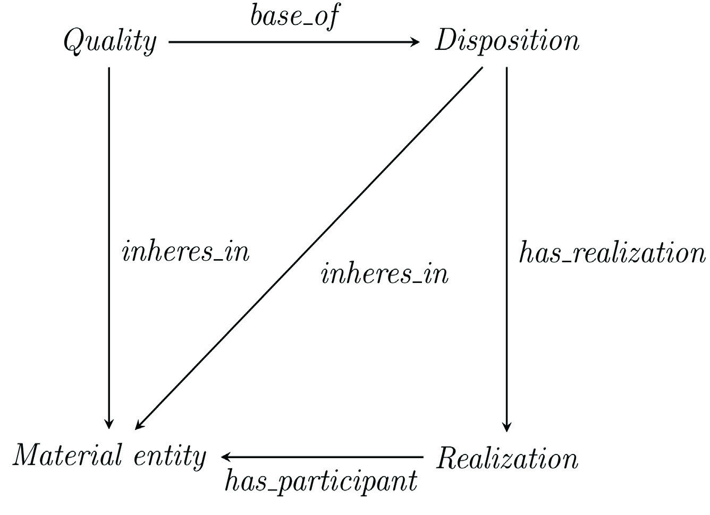
Notes:
Röhl and Jansen Journal of Biomedical Semantics 2011, 2(Suppl 4):S4 http://www.jbiomedsem.com/content/2/S4/S4

Slide 45
has base
Surface Grain Structure
Disposition to appear red
inheres in
inheres in
realized in
Paint
Color Experience
has participant
Notes:
Röhl and Jansen Journal of Biomedical Semantics 2011, 2(Suppl 4):S4 http://www.jbiomedsem.com/content/2/S4/S4

Slide 46
Information and their Bearers

Slide 47
Instance
Quality Specification
prescribes
Length

Slide 48
Instance
Quality Specification
part of
Design Specification Document
prescribes
Length

Slide 49
Instance
Quality Specification
part of
Design Specification Document
inheres in
Information Bearing Entity 1
prescribes
Length

Slide 50
Instance
Quality Specification
part of
Design Specification Document
inheres in
Information Bearing Entity 1
inheres in
part of
Information Bearing Entity 2
prescribes
has text value
Length
is measurement unit of
xsd: “The length of the part should be between 1.1 and 1.3 millimeters.”
Measurement Unit in Millimeters

Slide 51
Instance
Quality Specification
Design Specification Document
Information Bearing Entity 1
Class
Information Bearing Entity 2
has instance
has instance
has instance
has instance
Information Content Entity
has instance
Material Entity
Measurement Unit in Millimeters

Slide 52
Realizable Entities and their Contexts

Slide 53
Realizable Entities and their Contexts
Asserted Class
Instance
Defined Class
Employee Role 1
Person
subclass of
bearer of
≡ Employee
instance of
Sally

Slide 54
Realizable Entities and their Contexts
Asserted Class
Instance
Defined Class
Employee Role 1
Employee Role 2
Person
subclass of
bearer of
bearer of
bearer of
≡ Employee
instance of
Sally

Slide 55
Realizable Entities and their Contexts
Asserted Class
Instance
Defined Class
Employee Role 1
Employee Role 2
Person
instance of
instance of
subclass of
bearer of
≡ Employee
Staff Role
has organizational context
instance of
has organizational context
Autodesk
Sally
NIST
instance of
instance of
Organization

Slide 56
Realizable Entities and their Contexts
Act of Receiving Salary
Asserted Class
Act of Receiving Health Insurance
realized in
Instance
Defined Class
realized in
Employee Role 1
Employee Role 2
Person
instance of
instance of
subclass of
bearer of
≡ Employee
Staff Role
has organizational context
instance of
has organizational context
Autodesk
Sally
NIST
instance of
instance of
Organization

Slide 57
Realizable Entities and their Contexts
Software Creation
Asserted Class
Act of Hiring
realized in
Instance
realized in
Defined Class
CTO Role
Consultant Role
Person
instance of
instance of
subclass of
bearer of
≡ Employee
Professional Role
has organizational context
instance of
has organizational context
Autodesk
Sally
NIST
instance of
instance of
Organization

Slide 58
Signing Contracts for Services

Slide 59
Instance
Signing Contracts for Services
agent in
participates in
Person
Act of Buying
Service
Notes:
This picture is too simple. Services are Processes. If one signs a service agreement but never requests the service, then the service is not performed—but certainly one purchased something. This picture can’t account for this scenario.

Slide 60
Instance
Signing Contracts for Services
agent in
participates in
Person
Act of Buying
Service
Notes:
So don’t do this.

Slide 61
The Document Acts Ontology (D-Acts)
BFO: generically dependent continuant
BFO: process
Basic Formal Ontology (BFO),
Open Biological Investigations (OBI),
and
Information Artifact Ontology (IAO)
is a
is a
OBI: planned process
IAO: information content entity
is a
Document Acts Ontology (D-acts)
is a
social act
IAO: document
is a
has specified output
deontic declaration
is a
is a
document template
has specified input
has specified output
document act
BFO: role

Slide 62
Signing Contracts for Services
Instance
Organization
participates
agent in
Act of Buying
has process part
Document Act
Person
Time One

Slide 63
Signing Contracts for Services
Instance
Obligation Role
bearer of
Contract
input in
has output
Organization
participates
agent in
Act of Buying
has process part
Document Act
Person
bearer of
has output
Time Two
Claimant Role

Slide 64
Signing Contracts for Services
Instance
Obligation Role
bearer of
fulfilled
Contract
input in
has output
Organization
participates
agent in
has process part
Act of Service
Person
Act of Buying
Document Act
bearer of
has output
fulfilled
Time Three
Claimant Role

Slide 65
Training, Developing Skills, Using Skills

Slide 66
Training, Developing Skills, Using Skills
Instance
Service Plan Specification
Sally

Slide 67
Training, Developing Skills, Using Skills
Instance
Act of Plan Adoption
input in
Service Plan Specification
agent in
Sally
has output
Disposition to Provide Service
Notes:
There is a general distinction between two uses of plan. The first is a plan specification, which is an information content entity (generically dependent continuant) that may or may not ever be adopted. Then there is the disposition that results from having an adopted such a plan. These two moments are important in the life of strategic decision making. Here, Sally has adopted a plan specification as a disposition that now resides within her to carry out a plan according to a series of steps specified in the specification.

Slide 68
Training, Developing Skills, Using Skills
Instance
Act of Plan Adoption
input in
Service Plan Specification
agent in
Sally
prescribes
has output
agent in
inheres in
Disposition to Provide Service
realized in
Act of Service

Slide 69
Training, Developing Skills, Using Skills
Instance
Act of Plan Adoption
input in
Service Plan Specification
Serm
bearer of
bearer of
agent in
Sally
prescribes
Preference
agent in
Customer Role
has output
agent in
realized in
realized in
inheres in
Act of Customer Evaluation
Disposition to Provide Service
realized in
Act of Service
Notes:
Serm is later asked about the service he was provided.

Slide 70
Training, Developing Skills, Using Skills
Instance
Act of Plan Adoption
input in
Service Plan Specification
Serm
bearer of
bearer of
agent in
Sally
prescribes
Preference
agent in
Customer Role
has output
agent in
realized in
realized in
inheres in
Act of Customer Evaluation
Disposition to Provide Service
realized in
Act of Service
is measurement of
has output
Information Bearing Entity
has part
has text value
inheres in
Service Evaluation
Customer Evaluation
xsd: “Very Poor”

Slide 71
Training, Developing Skills, Using Skills
Instance
Act of Plan Adoption
input in
Service Plan Specification
agent in
Sally
has output
agent_in
inheres in
Disposition to Provide Service
Act of Training
inheres in
has output
Customer Service Skills
Notes:
Because her first attempt at providing service didn’t go well, Sally undergoes further training, by which she acquires customer service skills.

Slide 72
Training, Developing Skills, Using Skills
Instance
Act of Plan Adoption
input in
Service Plan Specification
agent in
Sally
prescribes
has output
agent in
inheres in
Disposition to Provide Service
realized in
Act of Service
Customer Service Skills
realized in

Slide 73
Training, Developing Skills, Using Skills
Instance
Act of Plan Adoption
input in
Service Plan Specification
Dimitris
bearer of
bearer of
agent in
Sally
prescribes
Preference
agent in
Customer Role
has output
agent in
realized in
realized in
inheres in
Act of Customer Evaluation
Disposition to Provide Service
realized in
Act of Service
Customer Service Skills
realized in
is measurement of
has output
Information Bearing Entity
has part
has text value
inheres in
Service Evaluation
Customer Evaluation
xsd: “Excellent”
Notes:
This time, a different customer is surveyed, and her marks improve.

Slide 74
Creating Measurements and Ratios

Slide 75
Material Analysis
Asserted Class
Instance
Quality
instance of
instance of
Grain Size
Shape
bearer of
bearer of
Portion of Matter
bearer of
bearer of
Creep Strength
solid phase state
instance of
instance of
Disposition

Slide 76
Material Analysis
Asserted Class
Instance
Quality
instance of
instance of
instance of
Extension 1
Grain Size
Shape
has input
bearer of
Extension 2
bearer of
has output
Portion of Matter
Process of Creep
bearer of
realized in
bearer of
Creep Strength
solid phase state
instance of
instance of
Disposition

Slide 77
Material Analysis
Asserted Class
Instance
Quality
Defined Class
instance of
instance of
instance of
Extension 1
has input
Act of Testing
Grain Size
Shape
has input
has input
bearer of
Extension 2
bearer of
has output
Portion of Matter
has output
Process of Creep
bearer of
realized in
bearer of
Creep Strength
Measurement of Creep Strength
is measurement of
solid phase state
≡Measurement of Creep Strength
instance of
instance of
instance of
Disposition

Slide 78
Acts of Testing and Acts of Analysis
has input
Act of Testing 1
has input
Temporal Region
Location
is measured by
has output
Location Measurement 1
is measured by
has input
Act of Testing 2
Location
has output
Location Measurement 2
has output
Temporal Region Measurement

Slide 79
Acts of Testing and Acts of Analysis
has input
Act of Testing 1
has input
Temporal Region
Location
is measured by
has output
Location Measurement 1
is measured by
is input in
has input
Act of Testing 2
Location
has output
Act of Analysis 1
is input in
Location Measurement 2
has output
has output
Temporal Region Measurement
Length Measurement
is measured by
Spatial Region

Slide 80

Acts of Testing and Acts of Analysis
has input
Act of Testing 1
has input
Temporal Region
Location
is measured by
has output
Location Measurement 1
is measured by
is input in
has input
Act of Testing 2
Location
has output
Act of Analysis 1
is input in
Location Measurement 2
has output
has output
Temporal Region Measurement
Length Measurement
prescribes
is input in
is measured by
is input in
Act of Analysis 2
has output
Average Speed Measurement
Spatial Region
Notes:
Note to self: Velocity is not speed. ☺

Slide 81
Thank You
For these slides, the handout, and all ontologies discussed here, see:
https://github.com/NCOR-US/CHAMP
Email further questions to: J. Neil Otte, neilotte@gmail.com

